Slide 1
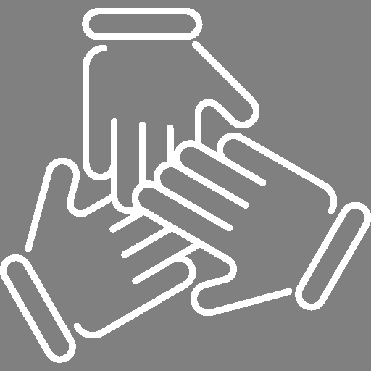
Data Science & Generative AI
Dr Michael Mortenson Associate Professor (Reader)
michael.mortenson@wbs.ac.uk
Session 5: Ensemble Models

Slide 2
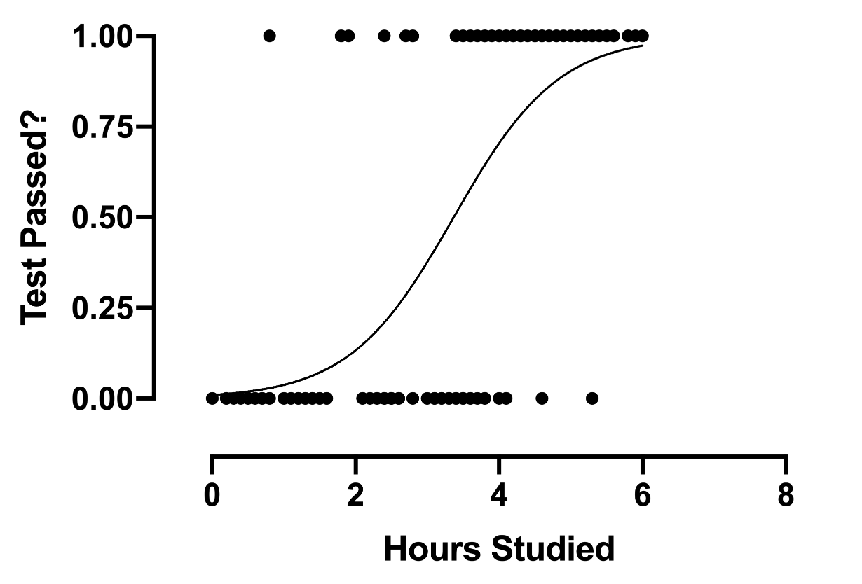
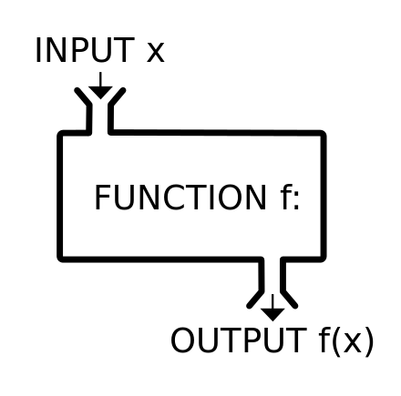
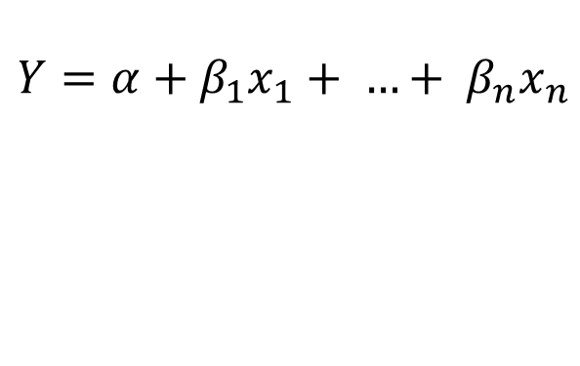
1.1 The Story So Far …
$$Y=α+β_{1}x_{1}+ …+ β_{n}x_{n}$$
Sigmoid / logistic function: Takes the regression output and turns it into the probability of class 1 (0 to 1)

Slide 3
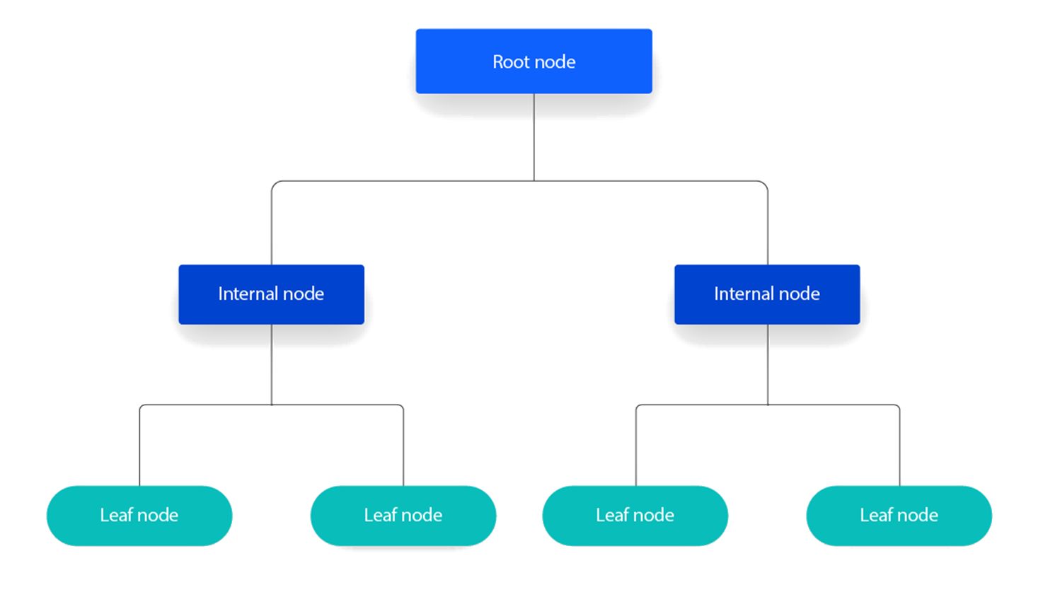
1.1 The Story So Far …
Parent
Child
Source: https://www.ibm.com/topics/decision-trees

Slide 4
1.3 However …
Logistic Regression
Limited to linear problems – many problems are non-linear;
Fixed parameter size (number of features + 1). Means that we likely underfit complex problems.
Decision Trees
In practice, one of two things happens:
We learn a model that is too simple (tree is too shallow) and we underfit;
We learn a model that is too complex (tree is too deep) and we overfit.

Slide 5
1.4 AI Building Blocks
Software has eaten the world.
AI has eaten software.
Machine learning has eaten AI.
Neural networks have eaten machine learning.
We’ll learn about neural networks next week.
Learning about neural networks is much easier if we first understand logistic regression and the stuff we’ll talk about today.
Notes:
dat

Slide 6

1.5 MDTGA
Notes:
Making Decision Trees GREAT Again

Slide 7
1.6 Building Models is Hard
Accuracy
Complexity / Effort
Notes:
We do so by recognising this truth. Building complex models is hard. Either we are really careful about it and it will take a lot of time, intelligence and skill. Or, we are relatively quick about it and we overfit.

Slide 8
1.7 If Your Problem …
Is relatively non-complex;
Will be based on relatively small data;
Will be based on structured data;
Requires some form of explainability (explainable AI – XAI);
and/or
Needs to be completed (or prototyped) quickly …
Logistic regression or the methods we will discuss today are likely to perform best (and are still widely used in business).
Notes:
dat

Slide 9
Session Aims
Introduction
Random Forests
Gradient Boosted Decision Trees (GBDT)
Asynchronous Tasks

Slide 10
2.1 ML Programs: Code + data
programmed
learned

Slide 11
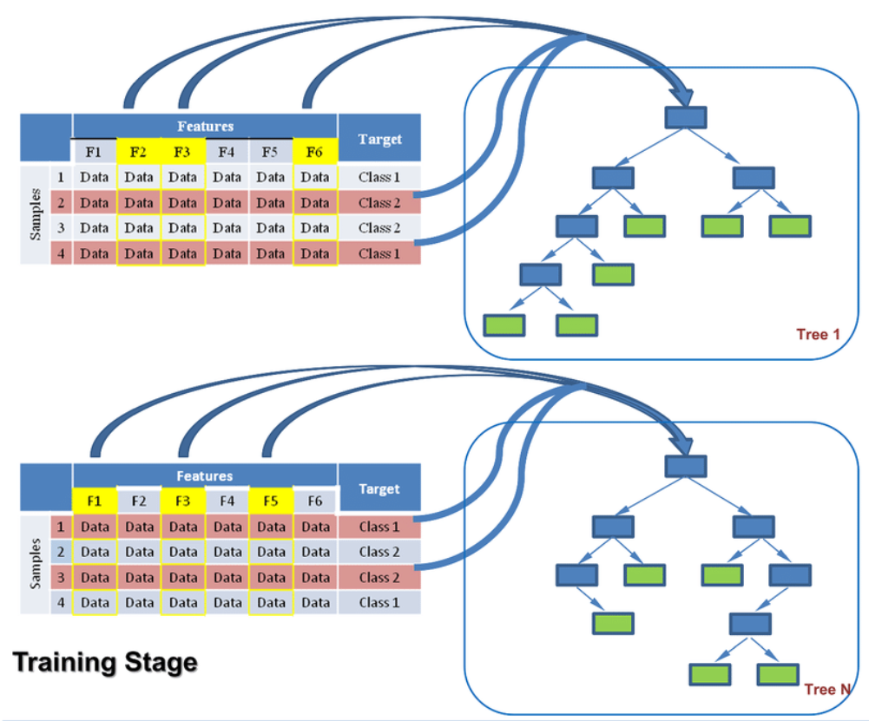
2.2 Random Forest
Virnodkar S et al. (2020). Remote sensing and machine learning for crop water stress determination in various crops: a critical review. Precision Agriculture 21.
Notes:
Basic random forest works by using some of the features in the data to build a tree; another set of features to build another tree; and so on. At prediction time, each tree (built on separate data) makes a prediction and the results are aggregated by mode or mean. If we have a classification problem each tree basically votes and the most popular choice wins (mode). If regression, every tree votes and we take the average as y_hat (mean).

Slide 12
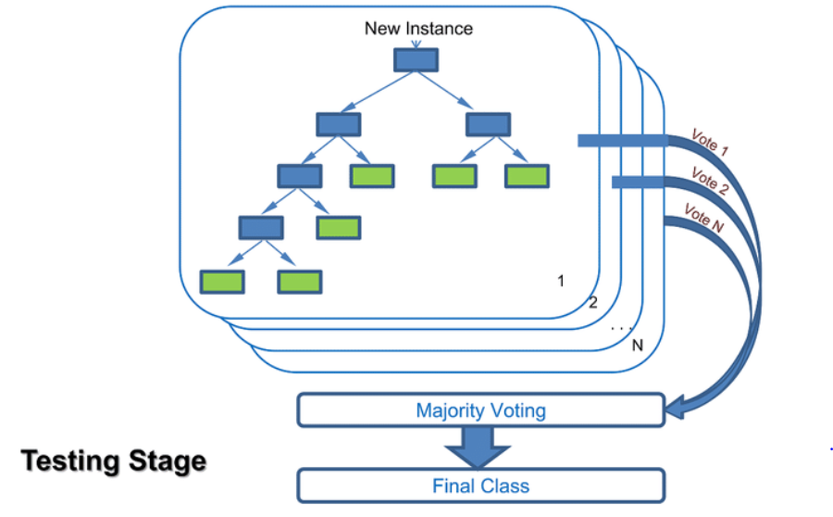
2.2 Random Forest
Prediction
Virnodkar S et al. (2020). Remote sensing and machine learning for crop water stress determination in various crops: a critical review. Precision Agriculture 21.
Notes:
Basic random forest works by using some of the features in the data to build a tree; another set of features to build another tree; and so on. At prediction time, each tree (built on separate data) makes a prediction and the results are aggregated by mode or mean. If we have a classification problem each tree basically votes and the most popular choice wins (mode). If regression, every tree votes and we take the average as y_hat (mean).

Slide 13
2.2 Random Forest
Random forests are an ensemble of decision trees all trained on different data;
We first split our dataset (N ) into M smaller chunks of data (usually by features). We then train M models, each trained on part of the data.
However, in many cases we do not want to reduce the size of our training data. We want all our trees to learn from a “full” dataset …
Notes:
dat

Slide 14
2.3 Bagging (Bootstrap Aggregating)
Real
Hypothesised / Estimated
Production (future) Data
The True Population
Unobtainable
The Training Sample
A Synthetic Sample
Obtainable
Notes:
dat

Slide 15
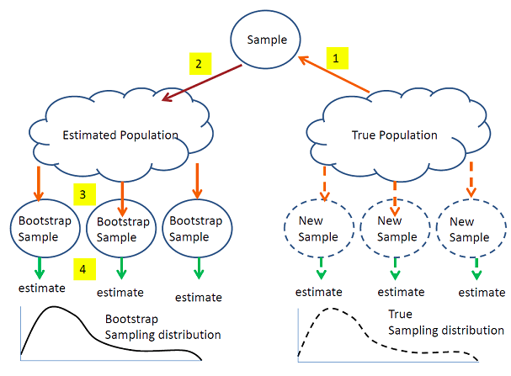
2.3 Bagging (Bootstrap Aggregating)
https://online.stat.psu.edu/stat555/node/119/
Notes:
dat

Slide 16
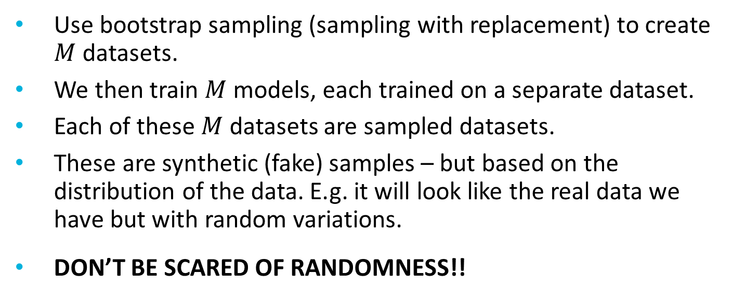
2.4 Random Forest (with Bagging)
Use bootstrap sampling (sampling with replacement) to create $M$ datasets.
We then train $M$ models, each trained on a separate dataset.
Each of these $M$ datasets are sampled datasets.
These are synthetic (fake) samples – but based on the distribution of the data. E.g. it will look like the real data we have but with random variations.
DON’T BE SCARED OF RANDOMNESS!!
Notes:
dat

Slide 17
2.5 Random Forest Hyperparameters
n_estimators: Number of trees to build (M ). Corresponds to the number of boostrapped data samples we will create.
The usual decision tree hyperparameters.

Slide 18
Session Aims
Introduction
Random Forests
Gradient Boosted Decision Trees (GBDT)
Asynchronous Tasks

Slide 19

3.1 What is the Hardest Part of Writing an Essay?
Image Credit: Blink. Blink. Blink. • Joe Peacock's Website

Slide 20

3.2 The Blindmen and the Elephant

Slide 21
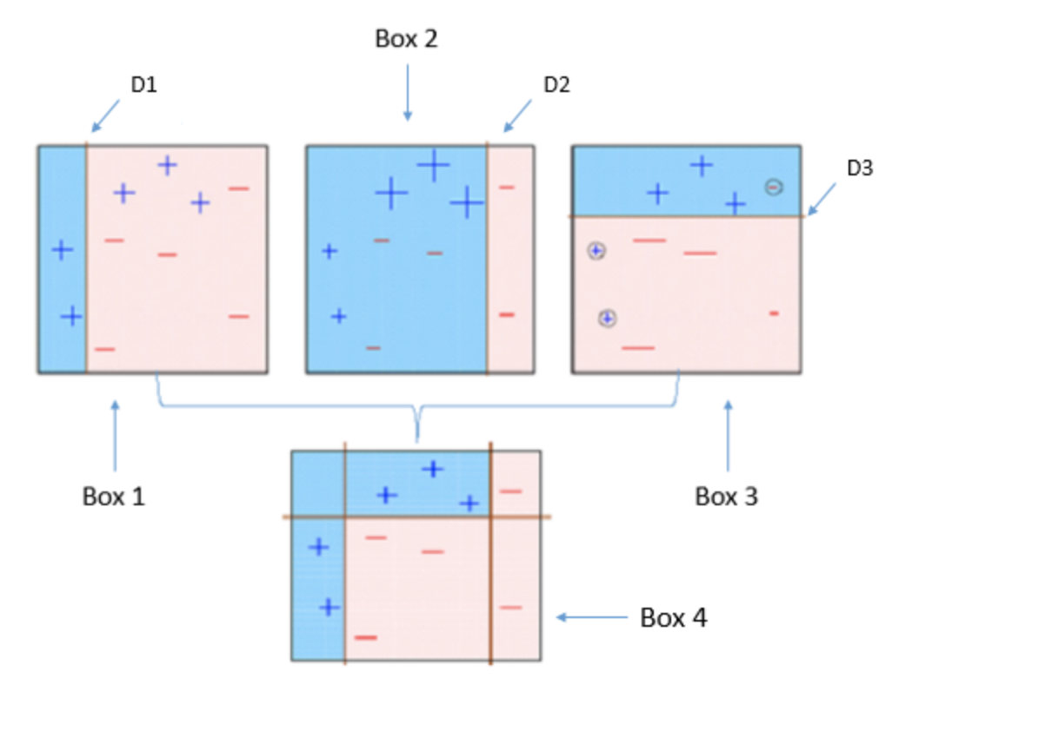
3.2 The Blindmen and the Elephant

Slide 22
3.3 Boosting
Begin with a very weak algorithm configuration (such as a max_depth=1 decision tree) and assign data and initial weight (all data assigned an equal weight of 1/𝑛);
Run the decision tree algorithm;
Increase the weights for data which was incorrectly classified, and decrease the weights for data correctly classified;
Run the algorithm with bias towards the higher weighted data. Add the resultant lines/rules to the existing model;
Repeat (3) to (4) until we reach the max trees / n_estimators hyperparameter. After multiple iterations, the algorithm will find a far more sophisticated model!
Notes:
datec

Slide 23
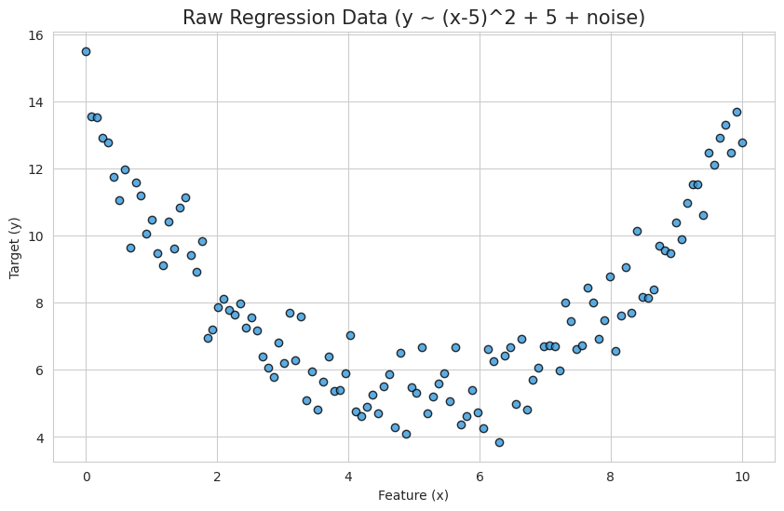
3.4 Gradient Boosted Decision Trees (Regression)
Notes:
We are going to perform regression on this data … which is neither simple of linear

Slide 24
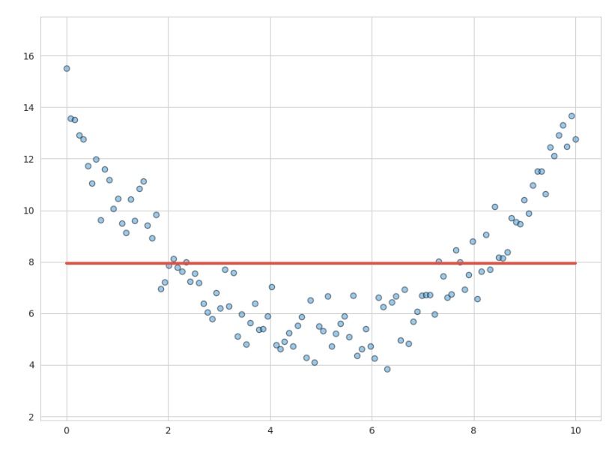
3.4 Gradient Boosted Decision Trees (Regression)
Notes:
We first build a very simple model … y = 7.9. It is clearly too simple. From this tree we have residuals … measures of error. Effectively this is y - y_hat.

Slide 25
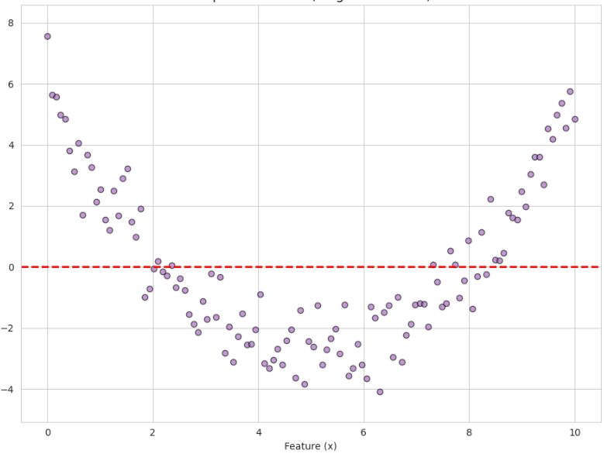
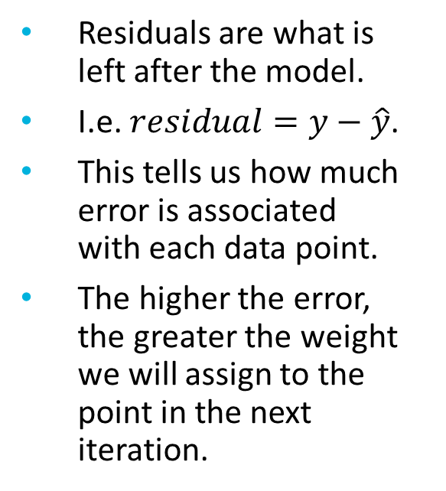
3.4 Gradient Boosted Decision Trees (Regression)
Residuals are what is left after the model.
I.e. $residual=y−\hat{y}$.
This tells us how much error is associated with each data point.
The higher the error, the greater the weight we will assign to the point in the next iteration.

Slide 26
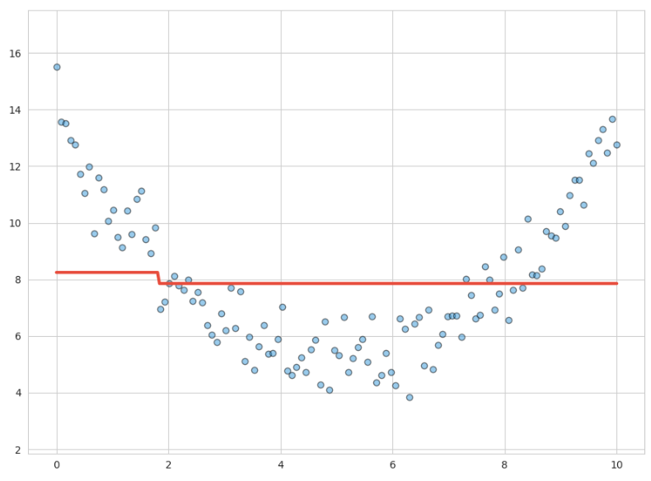
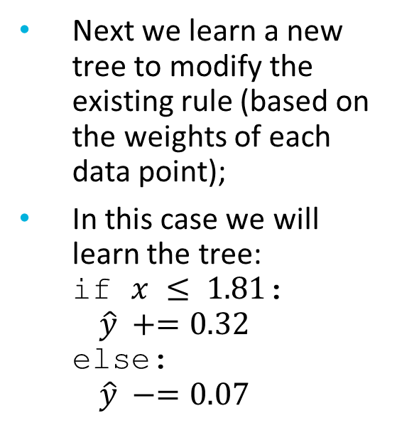
3.4 Gradient Boosted Decision Trees (Regression)
Next we learn a new tree to modify the existing rule (based on the weights of each data point);
In this case we will learn the tree: if $x ≤ 1.81$: $\hat{y} +=0.32$ else: $\hat{y} −=0.07$

Slide 27
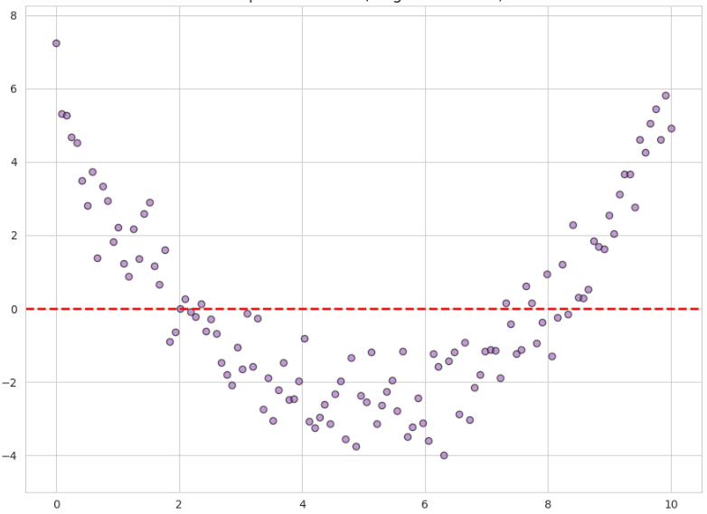
3.4 Gradient Boosted Decision Trees (Regression)
Notes:
Previous residuals (left) vs new residuals (right)

Slide 28
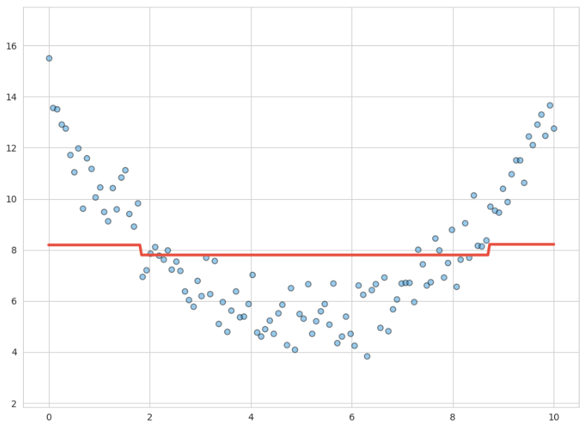
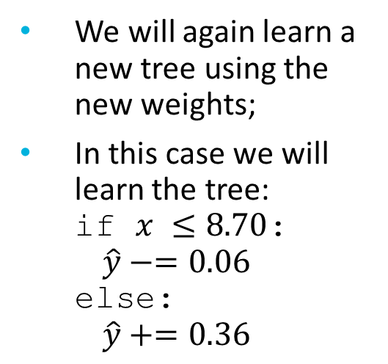
3.4 Gradient Boosted Decision Trees (Regression)
We will again learn a new tree using the new weights;
In this case we will learn the tree: if $x ≤8.70$: $\hat{y}−=0.06$ else: $\hat{y}+=0.36$

Slide 29
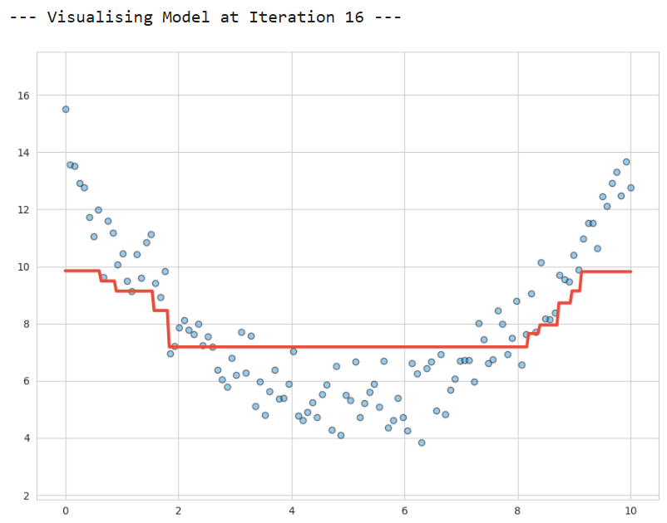
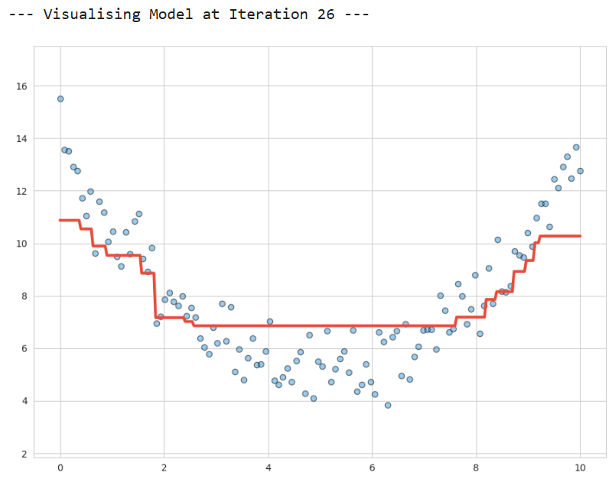
3.4 Gradient Boosted Decision Trees (Regression)

Slide 30
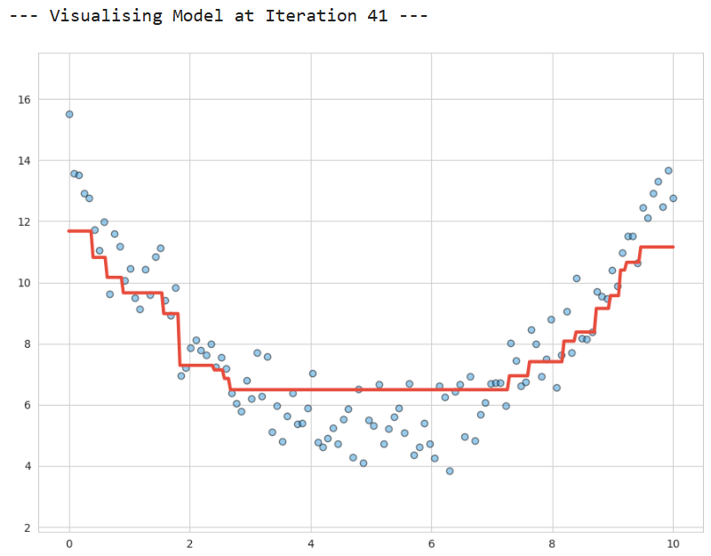
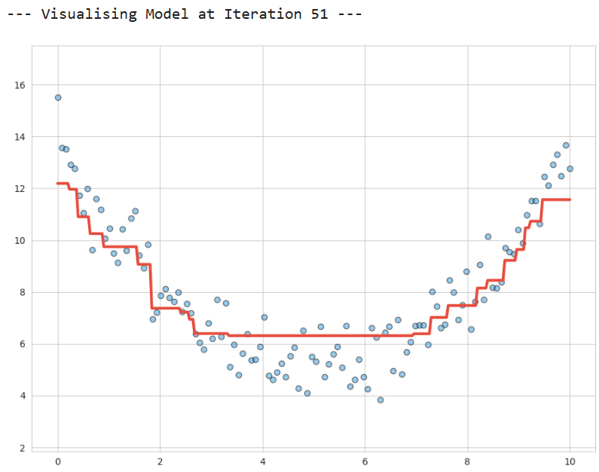
3.4 Gradient Boosted Decision Trees (Regression)

Slide 31
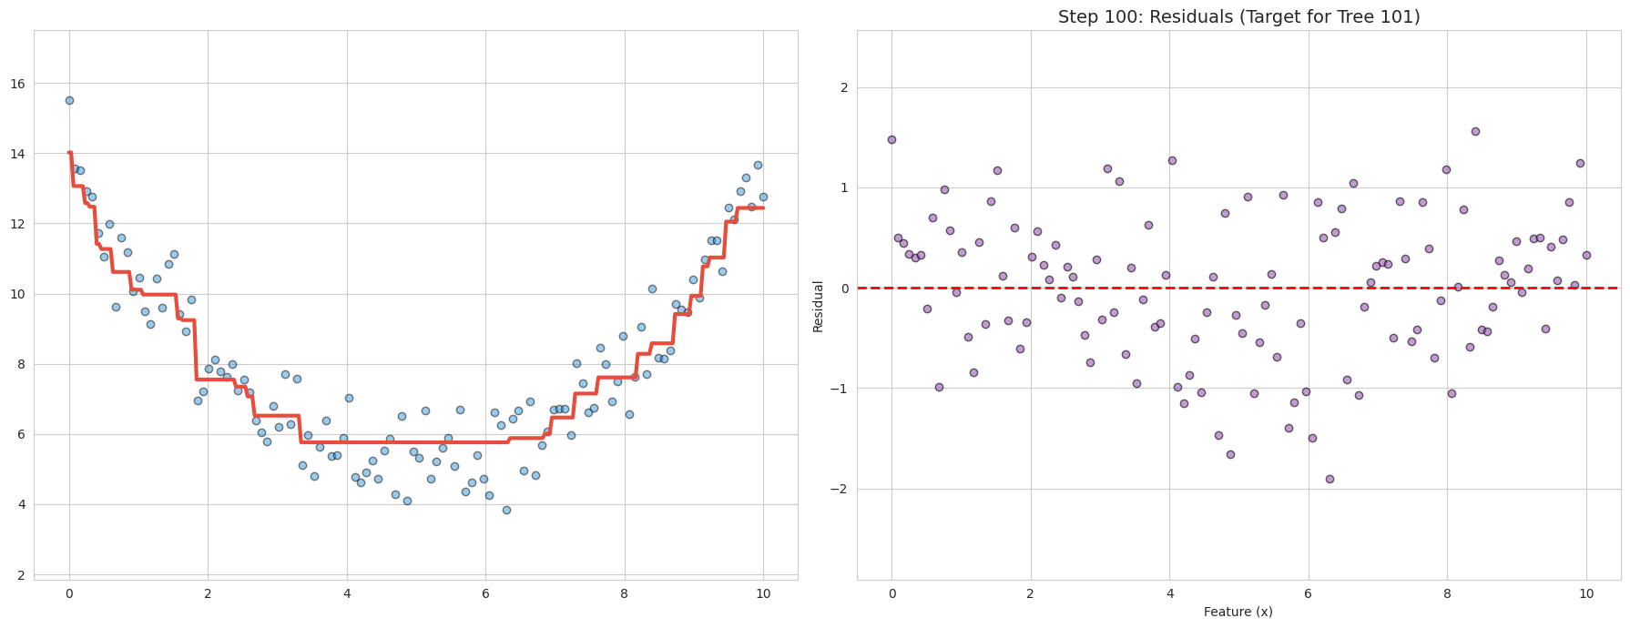
3.4 Gradient Boosted Decision Trees (Regression)

Slide 32
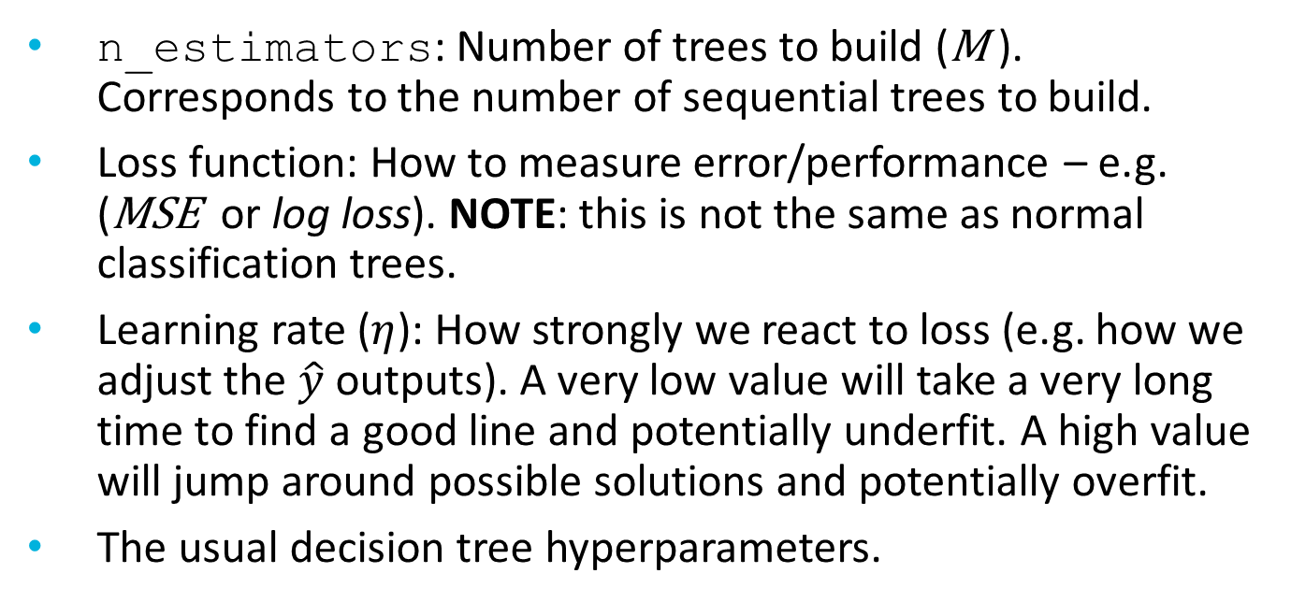
3.5 GBDT: Hyperparameters
n_estimators: Number of trees to build (M ). Corresponds to the number of sequential trees to build.
Loss function: How to measure error/performance – e.g. (MSE or log loss). NOTE: this is not the same as normal classification trees.
Learning rate ($η$): How strongly we react to loss (e.g. how we adjust the $\hat{y}$ outputs). A very low value will take a very long time to find a good line and potentially underfit. A high value will jump around possible solutions and potentially overfit.
The usual decision tree hyperparameters.

Slide 33
3.8 MDTGA
Notes:
Making Decision Trees GREAT Again … by making lots of them either concurrently or consecutively

Slide 34
Session Aims
Introduction
Random Forests
Gradient Boosted Decision Trees (GBDT)
Asynchronous Tasks

